Slide 1
MGT 40750 – Quantitative Decision Modeling Spring 2017 Spreadsheet Simulation Using @Risk
Professor Hong Guo

Slide 2
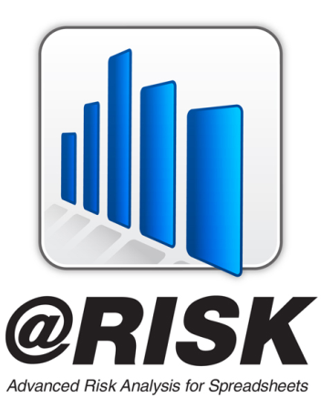

Spreadsheet Simulation Using @Risk
Palisade and @Risk
Palisade Corporation is the maker of the market leading risk and decision analysis software @RISK and the DecisionTools® Suite.
Virtually all Palisade software adds in to Microsoft Excel, ensuring flexibility, ease-of-use, and broad appeal across a wide range of industry sectors.
Its flagship product, @RISK, debuted in 1987 and performs risk analysis using Monte Carlo simulation. With an estimated 150,000 users, Palisade software can be found in more than 100 countries and has been translated into seven languages.
Customers: http://www.palisade.com/industry/customers.asp

Slide 3
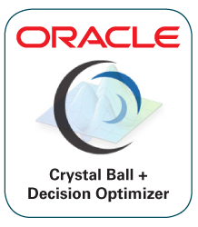
Competing Product
Oracle and Crystal Ball
As a result of its acquisition of Hyperion, Oracle has also acquired Decisioneering, makers of Crystal Ball software.
Crystal Ball software is a leading spreadsheet-based software suite for predictive modeling, forecasting, Monte Carlo simulation and optimization.
With over 4,000 customers worldwide, including 85% of the Fortune 500, Crystal Ball is used by customers from a broad range of industries, such as aerospace, financial services, manufacturing, oil and gas, pharmaceutical and utilities.
Crystal Ball is used in over 800 universities and schools worldwide for teaching risk analysis concepts.

Slide 4
@Risk Features
@Risk contains a good collection of probability distribution functions such as RISKNORMAL and RISKDISCRETE.
Excel cells can be designated as output cells. @Risk automatically keeps summary measures such as averages, standard deviations, percentiles, etc. for the output cells.
@Risk has a special function, RISKSIMTABLE, that allows you to run the same simulation several times, using a different value of some key input variable each time.
Read more about @Risk on pages 561-572 in the text.

